Slide 1
Diff eq pt 2 ch 6

Slide 2
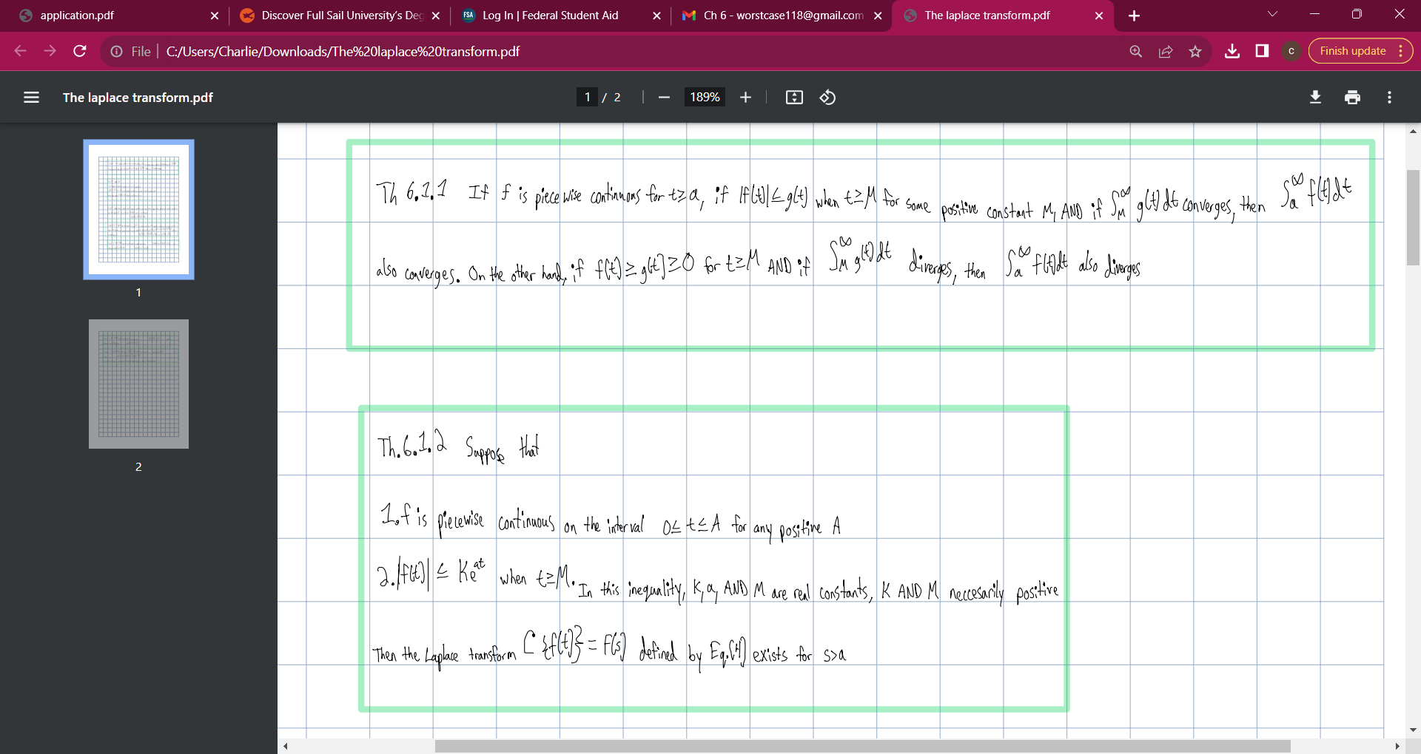

Slide 3
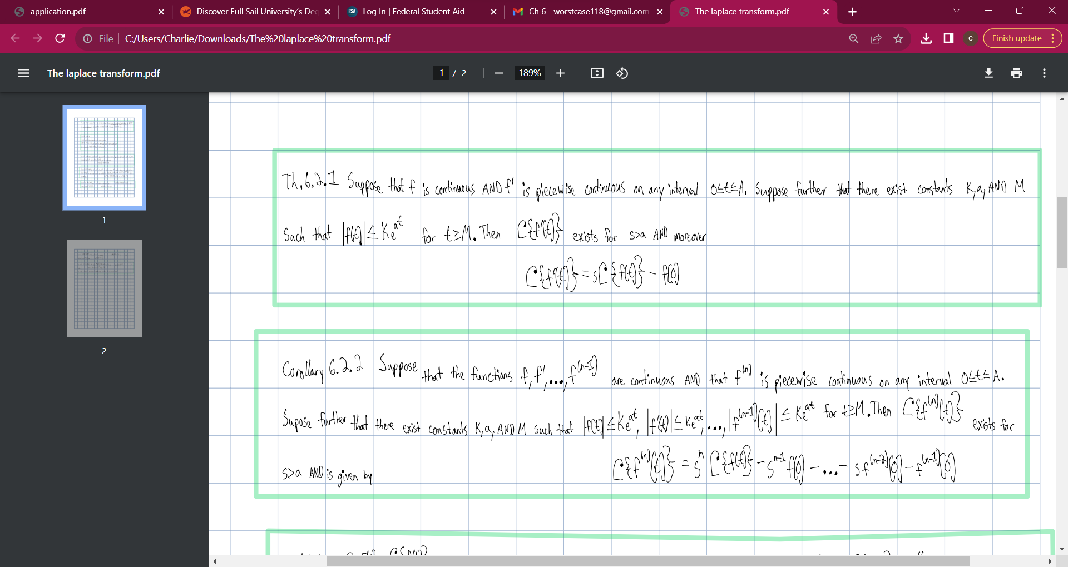

Slide 4
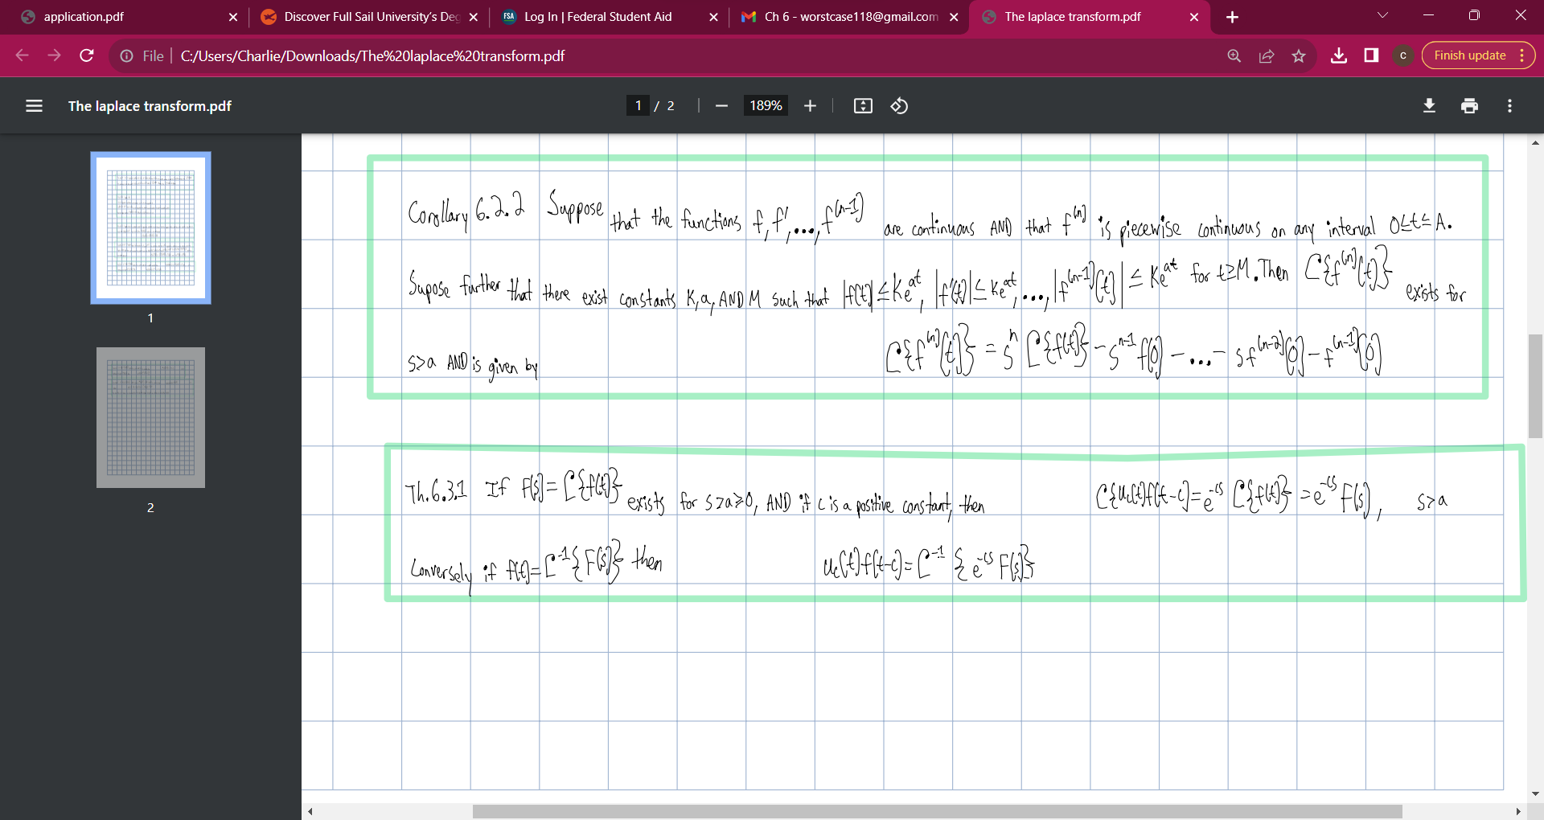

Slide 5
